Slide 1
Intro to Git
Welcome to the pit.
A presentation heavily borrowed from datacamp and cobbled together with some other things

Slide 2
Git Agenda
Git Background
Git Setup
Git Workflow
Git Collaboration
Notes:
Mac - Homebrew
Windows - nothing

Slide 3
I’ve never heard of git
“
I'm an egotistical bastard, and I name all my projects after myself. First 'Linux', now 'Git’…but git can mean anything, depending on your mood:
Random three-letter combination that is pronounceable, and not actually used by any common UNIX command. The fact that it is a mispronunciation of "get" may or may not be relevant.
Stupid. Contemptible and despicable. Simple. Take your pick from the dictionary of slang.
"Global information tracker": you're in a good mood, and it actually works for you. Angels sing and light suddenly fills the room.
"Goddamn idiotic truckload of sh*t": when it breaks
”
Linus Benedict Torvalds – principal developer of the Linux kernel and creator of the distributed version control system Git
Notes:
Before we get started I want to warn everyone that this is a presentation about the RIGHT way to do git and since I’ve been using git solo for the last 8 months, I haven’t encountered any situations where git has gone wrong. There’s a good chance that won’t be the case here. But follow these steps and stick to the schedule, and you’ll be fine!
Who’s heard of git? Raise your hand if you’ve used git. If you have you’re free to leave or listen politely. If you know of better ways to do things, feel free to pipe in!
So git is a version control system developed by Linus Torvalds, who also invented the Linux operating system. Linus claims he named both things after himself. He has allegedly given a number of meanings for what git stands for – and to be honest, he’s 100% right that your attitude towards git really just depends on your day and your mood.
And to make my gif applicable to this talk and not totally self indulgent: As the Weasley twins say, it would be terrible to be stuck as one thing forever; git is a tool that allows us to make changes to our code and save our code history.

Slide 4
What even is git?
Twas the Night
Twas the Night V1
Twas the Night V2_DN
Twas the Night V2_DNSSedits
Twas the Night V2
Twas the Night V3_DN
Twas the Night V1_2
Notes:
So I mentioned that git is a version control system. There was a time before Google Drive and OneDrive, when you oculdn’t have multiple people write to a single document simultaneously. If you had a group project, each person would make edits to a document and share out the various versions as separate documents with fun and ever changing naming conventions. You may see some of that here.
As far as I know, there is no Google doc for code, nor would you really want one. If any user could overwrite another user’s code at any time, you would potentially lose important chunks of code. Git is a tool that helps you save everyone’s different versions of the code.

Slide 5
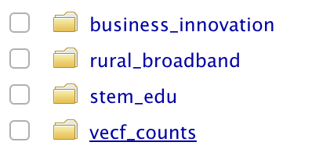
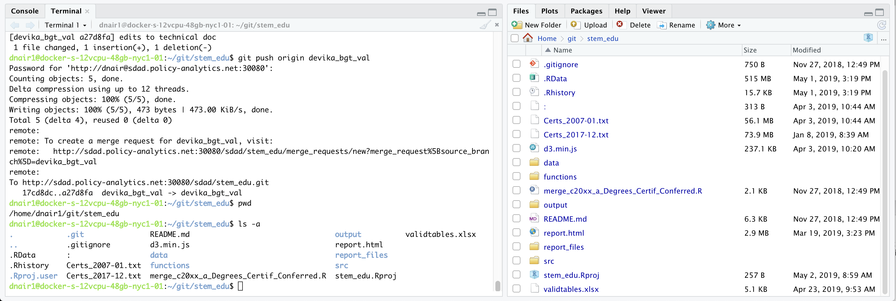
How do git repositories work?
Git repositories are basically project folders containing:
project directory: directory containing all the files and folders associated with your project
git directory: directory containing all the extra information required to capture changes between versions.
Notes:
How does git work?
Git works by saving information into one of two places. One place is the project repository – which is the collection of files and directories associated with your project work. In this example, we’re looking at the stem_edu project, which has all of these different folders for data, code, and plots. Think of git similar to Time Machine for Mac. Time Machine remembers what your entire computer looks like at a single point in time. Git also remembers what the universe of your project repository looks like in various points in time. Then, when you make changes to your folder – maybe you write new code or generate new figures – git notes the difference between the last version of your repository and your newest version, and saves the information about the changes to the git directory. Because the git directory is a hidden file, you can’t see it on the right. So I use Terminal’s command line to see the .git folder. You’ll never need to look at this but it is good to know that this is how it works.
One thing to note here, our project repositories will always have a data, source, functions, and output folder, since that is our standard project folder structure. However, the data folder, and any physical data, will NOT be part of what’s saved in git. The reason for this is that data gets too big to be saved online in GitHub and it’s not efficient to do so. So we create a .gitignore file that will ignore any data files when looking for changes to capture in the git directory.
---
Where does Git store information?
Each of your Git projects has two parts: the files and directories that you create and edit directly, and the extra information that Git records about the project's history. The combination of these two things is called a repository.
Git stores all of its extra information in a directory called .git located in the root directory of the repository. Git expects this information to be laid out in a very precise way, so you should never edit or delete anything in .git.

Slide 6

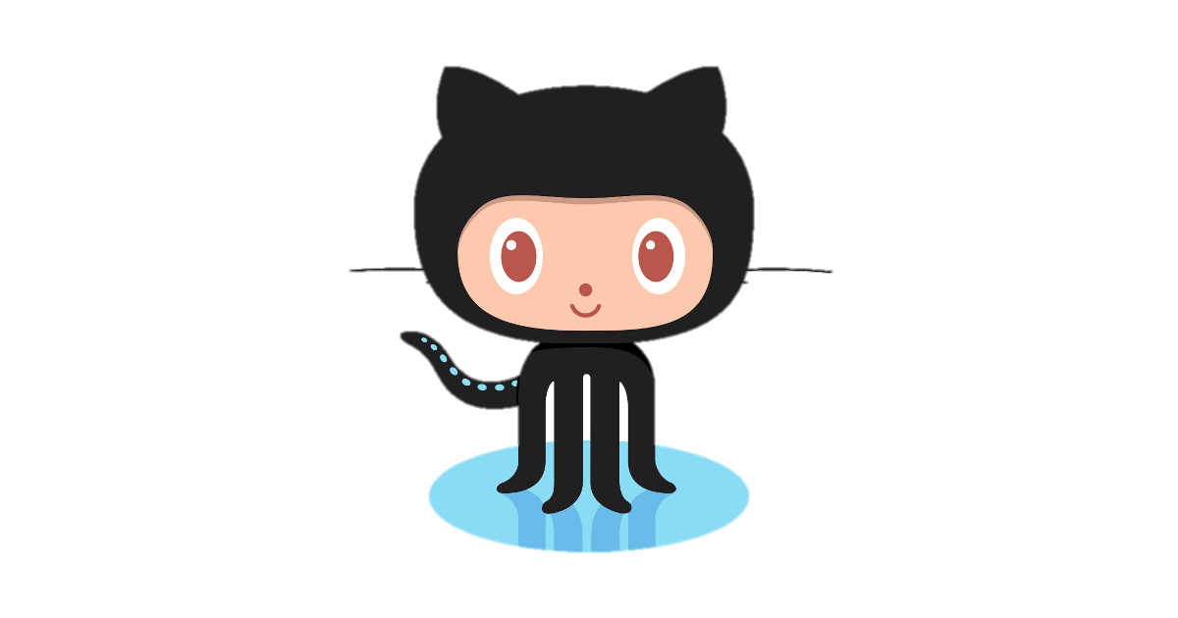

What even is git?
Gizem – Version 1
Devika – Version 2
Teja – Version 3
Notes:
I briefly touched on this just now, but when users make modifications to code – either on their personal machines or on the Rstudio server – they ultimately save or ‘push’ these changes to GitHub, an online repository of repositories. There’s a lot you can do in GitHub but for today, what you need to know is that GitHub will store all the versions of a project’s code and allow you to resolve the various versions into a single clean version.

Slide 7
What even is git?
Notes:
Here’s an example of that GitHub functionality. Here we see two versions of the code, where one user was able to continue building on an older version of the code. In this scenario, when we merge the two, the latest version will be the final version.

Slide 8

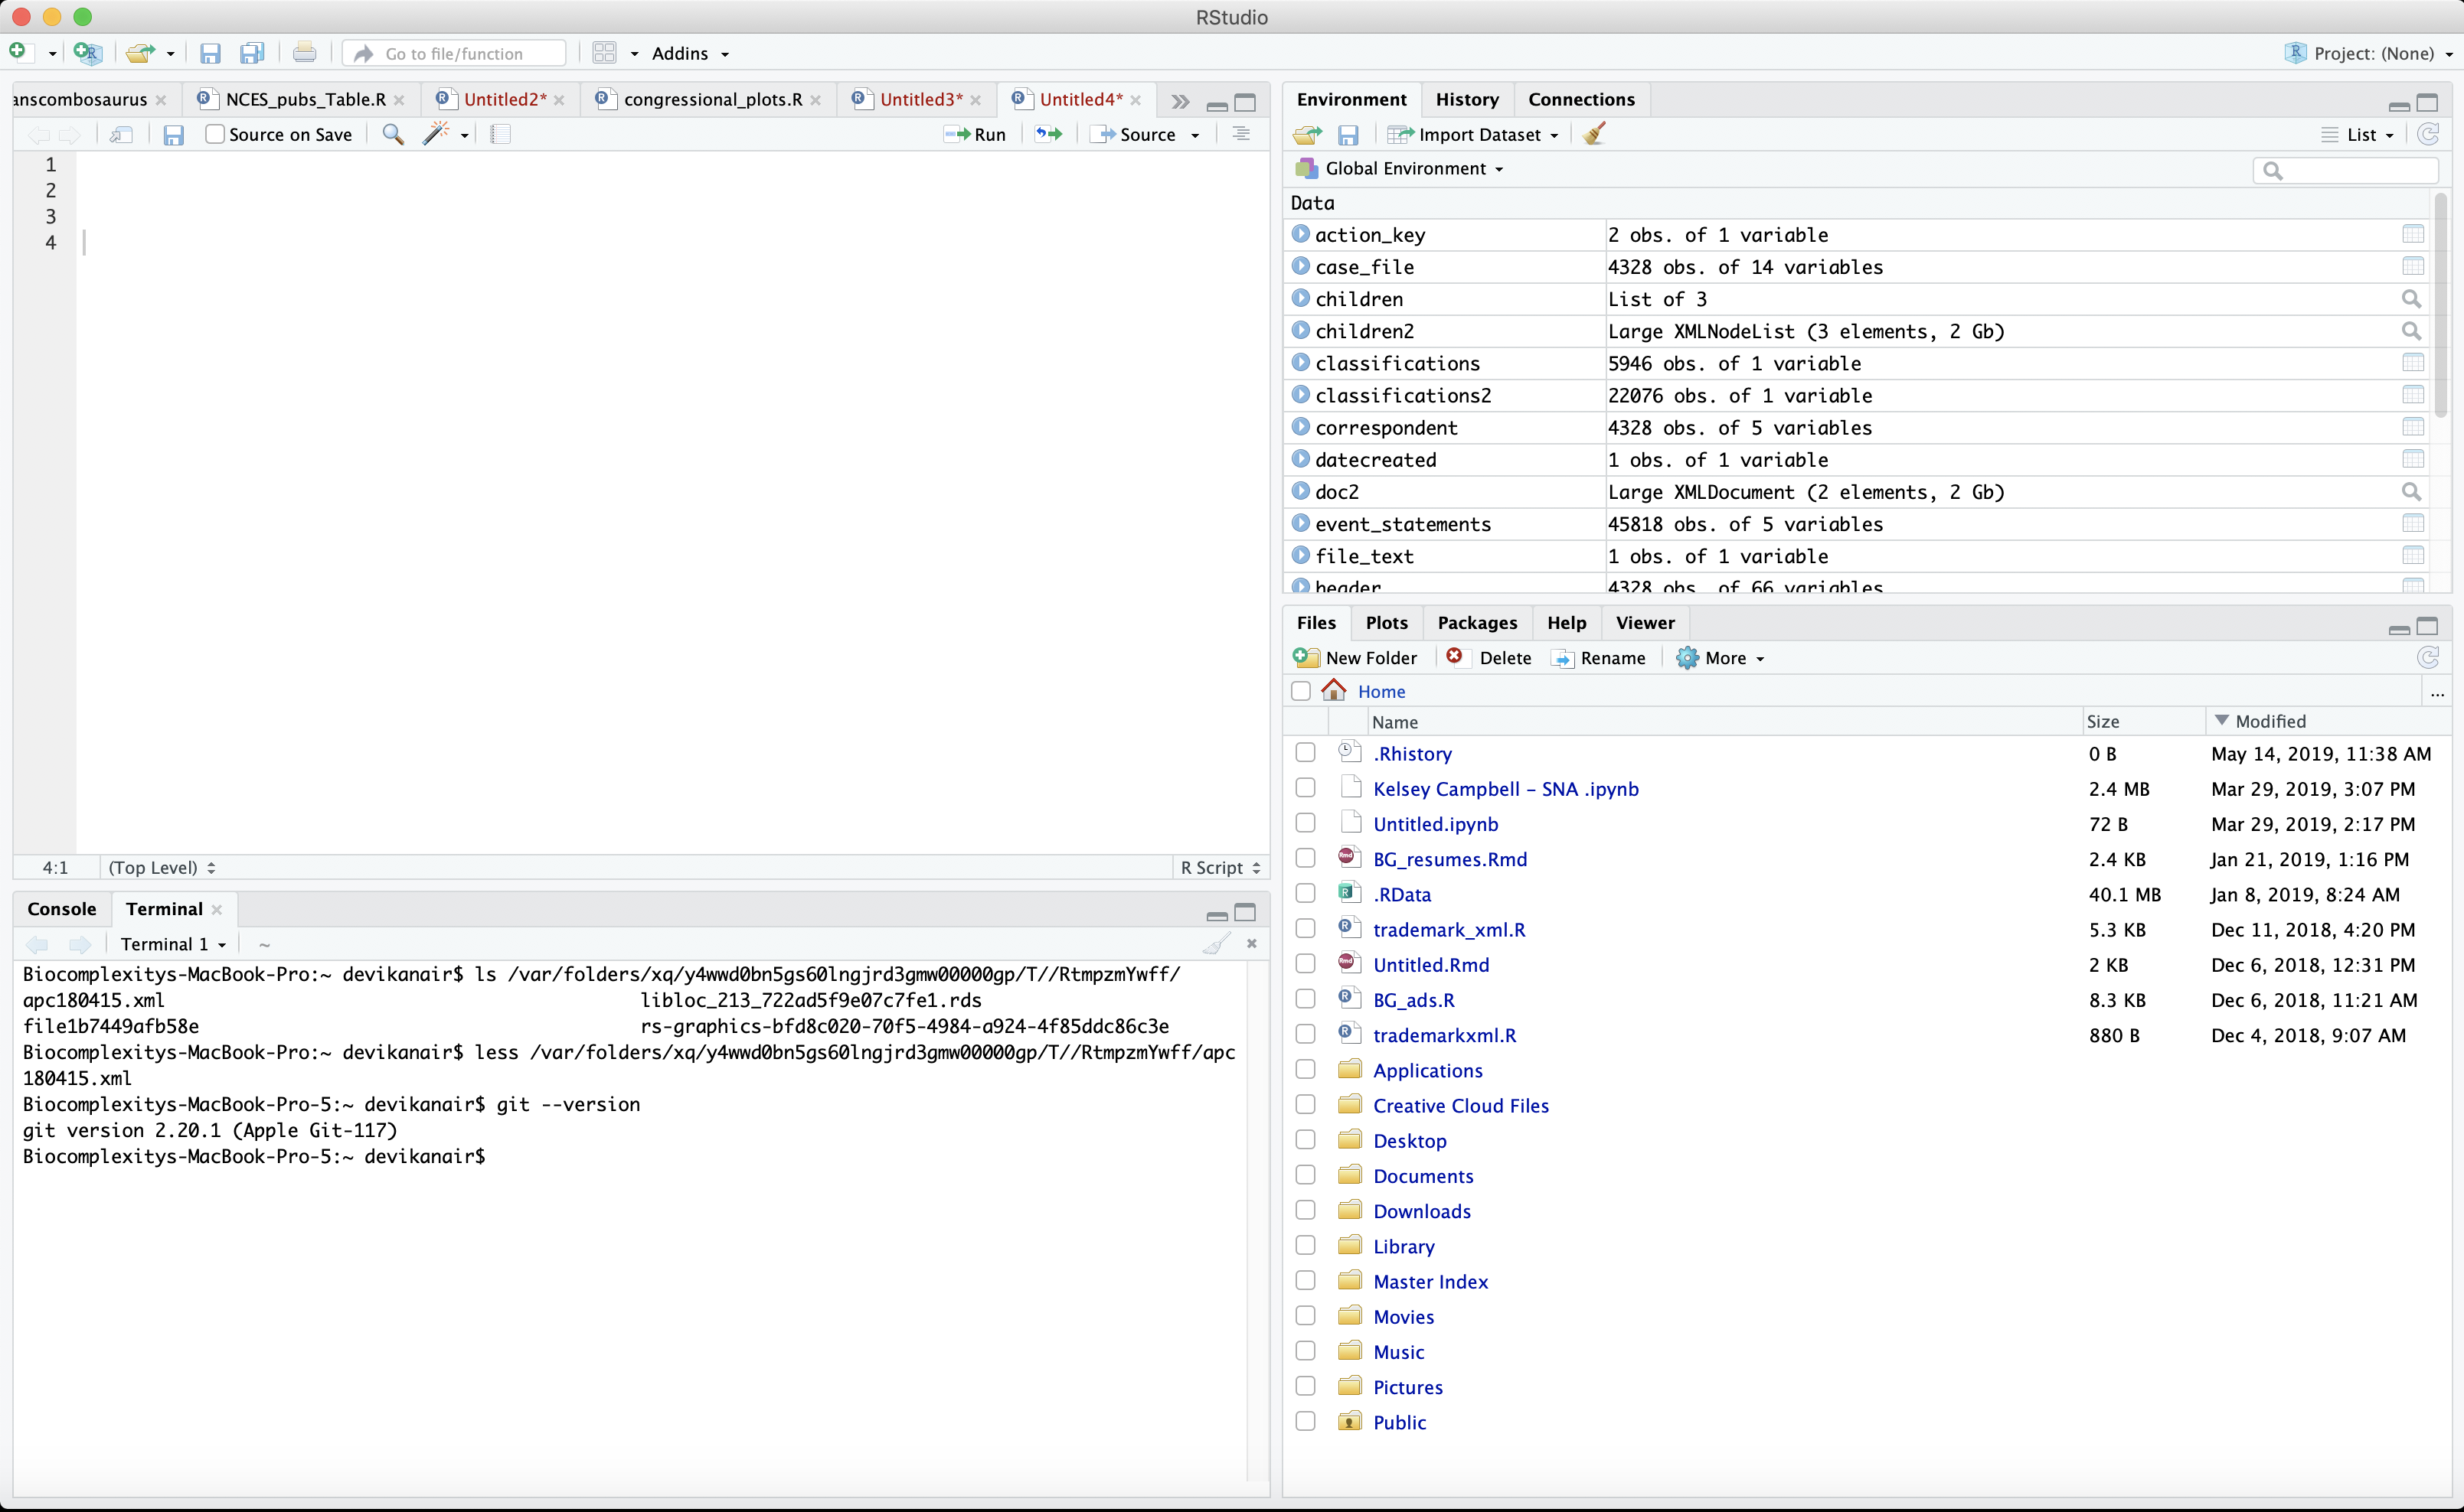
Where are we doing git?
All project-related code must be written to the RStudio server.
Your personal laptop and RStudio application is for practice, personal projects.
We will always do git in the terminal.
Notes:
We are about to start doing git configuration, but before we start with the doing, I want to make sure we all know where we’re working. How many of you have used Rstudio before?
Great so you know that this upper left hand is the source viewer for actual R code, the bottom left has the console and the terminal. The Terminal of the Rstudio server is where we will be doing git. Note that there are built in git tools we won’t be using, as they are not reliable. There are also desktop tools, which are great, but we can’t use them since they don’t plug in to the server.

Slide 9
Your Role
Monday - Group Meetings
Tuesday - Group Meetings
Wednesday - Work work work
Thursday - Work work work
Friday - Documentation Day!
Fellows responsible for reviewing and merging code?
Does it run?
No datasets are checked in?
Are there loops that can be written more simply with an apply or map function?
Is there repetitive code that could be written more simply using a custom function?
Are your assumptions about the data tested in code?

Slide 10
Let’s Git It Started
Git Setup
Git Installation
Git Configuration
Git Repositories
Notes:
Mac - Homebrew
Windows - nothing

Slide 11

Git On Up
Git Installation
Step 1: Check to see if you already have git installed.
Open up a terminal window
Enter the following
git --version
Results: If you see this, then:
git version 1.9.5.msygit.0
✓ YOU GOOD
‘git’ is not recognized as an internal or external command, operable program or batch file
x Do not pass go, instead go here:
https://git-scm.com/book/en/v2/Getting-Started-Installing-Git
You shall not pass go.

Slide 12
(I Can’t Git No) Satisfaction
Git Configuration
Step 2A: If you don’t already have a GitHub account, create one. If you do, log into it.
Step 2B: Check git setup on your computer
Review the current settings broadly, for all users on your computer, for all projects per current user, and per current project
git config --list
git config --list --system
git config --list --global
git config --list --local
Step 2C: Setup git on your computer
Add your name and email to your settings, using your GitHub email account
c
git config --global user.name “Devika Nair”
git config --global user.email dnair@fandm.edu
Notes:
To check step 2C –
git config --global user.name
git config –global user.email

Slide 13
Not Gonna Git Us
Git Configuration
Step 2D: Check SSH keys setup
Open terminal to check for existing SSH keys
ls –al ~/.ssh
Step 2E: Generate SSH keys
Use GitHub email address to generate new SSH keys
ssh-keygen
When prompted to “Enter a file”, just press Enter. This accepts default file location.
Enter a file in which to save the key (/home/you/.ssh/id_rsa): [Press enter]
When prompted to “Enter a passphrase”, just press Enter. This leaves it blank and makes life easier.
Enter passphrase (empty for no passphrase): [Type a passphrase]
Enter same passphrase again: [Type passphrase again]
Confirm you have the keys now
ls –al ~/.ssh

Slide 14
Git On Up
Git Configuration
Step 2F: Copy & save the key somewhere safe!
Use the following to copy the ssh key to your clipboard. Save it somewhere!
cat ~/.ssh/id_rsa.pub
Step 2G: Add your SSH key to your GitHub account
Navigate to GitHub settings, then SSH & GPG keys
Select New SSH Key and paste key into text field
Select Add SSH key
2H: Test your SSH connection manually
ssh -T git@github.com
If the fingerprint in the message looks like this, then you’re good to continue:
16:27:ac:a5:76:28:2d:36:63:1b:56:4d:eb:df:a6:48
SHA256:nThbg6kXUpJWGl7E1IGOCspRomTxdCARLviKw6E5SY8
yes

Slide 15


Come Togither
Git Repositories
Step 3A: Find your project on GitHub
Navigate to GitHub, find the STEM project under the uva-bi-sdad account
Copy the HTTPS link
Add your username and @ inside the url
https://DevikaNair90@github.com/
uva-bi-sdad/dspg19fairfax.git
Step 3B: Clone the project into your RStudio server space using Rstudio
File
New project
Version Control
Git
Repository URL <- https://DevikaNair90@github. com/uva-bi-sdad/dspg19fairfax.git
SDAD Project 1
SDAD Project 2
SDAD Project 3
＊
Server RStudio
Notes:
Step 3B – Command line option
Option 1: Using command line with HTTPS link adding your username inside the link
git remote add origin https://DevikaNair90@github.com/uva-bi-sdad/dspg19fairfax.git

Slide 16
HOMEWORK
Git Project
Step 3A: Create a personal project on GitHub
Name
Description
Visibility (set to Public)
Initialize with ReadMe (set to yes)
Step 3B: Clone project to the server
git clone https://DevikaNair90@github.com/ DevikaNair90/613-DCUnited
Devika Project 1
Recipe Dashboard
School Assignment
New Project
＊

Slide 17
Just remember – BWPM
Branch
Write
Push
Merge
Branch
Check git branch
Create git branch
Write
Write your code!
Push
Add your changes
Push your branch
Merge
Commit the changes
Review your code
Merge your branches
Merge branch into master
Bran
Writes
Pushy
Memos
Notes:
Big Waffles Pantry Materials
Black White Panda Mate
BoWPaM
Big Waves Paddle Motorboat
Banana Watermelon Pear Mango
Bran of Winterfell
Braavos Winterfell Pentos/Pit Meereen
Bran Writes Pushy Merger

Slide 18
How does git work?
Git Workflow
1. Write your code
2. Stage your code
3. Commit your code
4. Push your code
5. Merge your code
Notes:
THE BASICS, THE TAKEAWAY

Slide 19
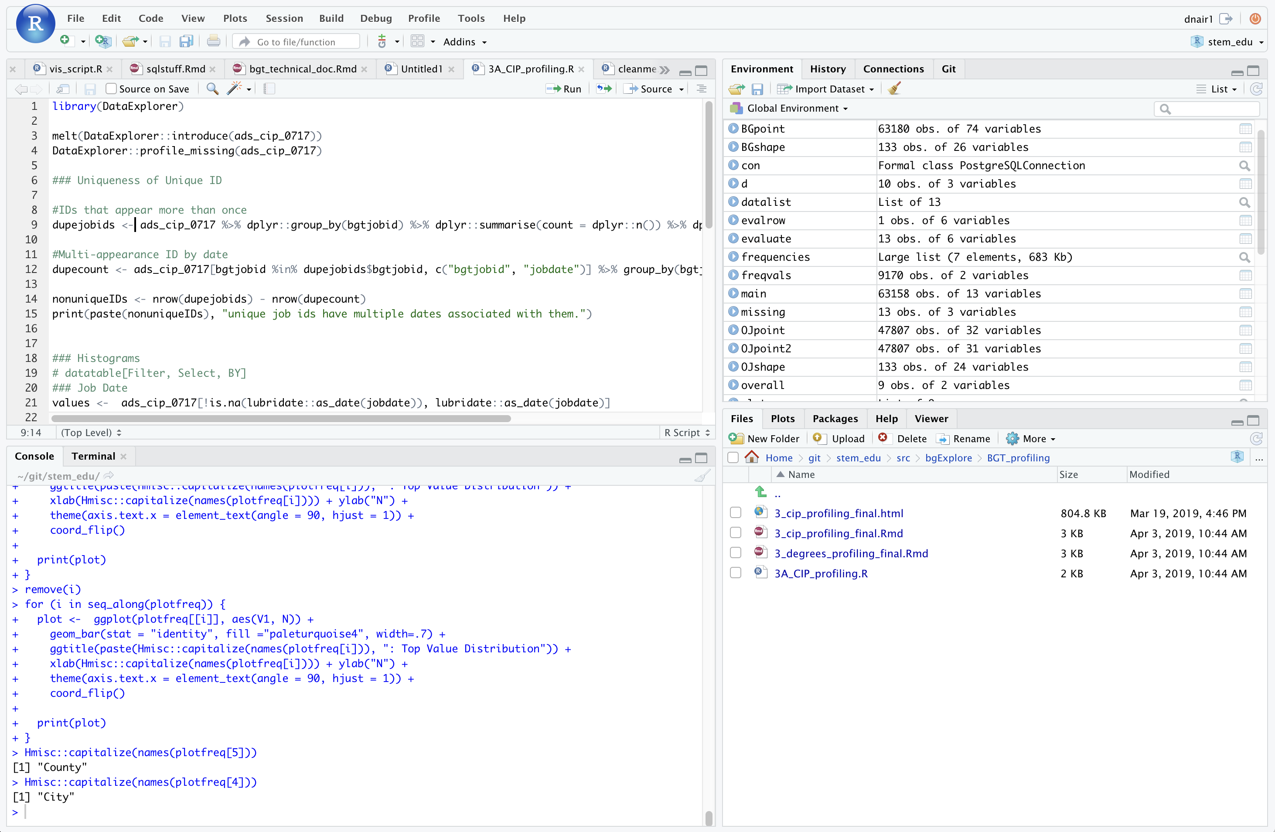
How does git work?
1. Write your code

Slide 20
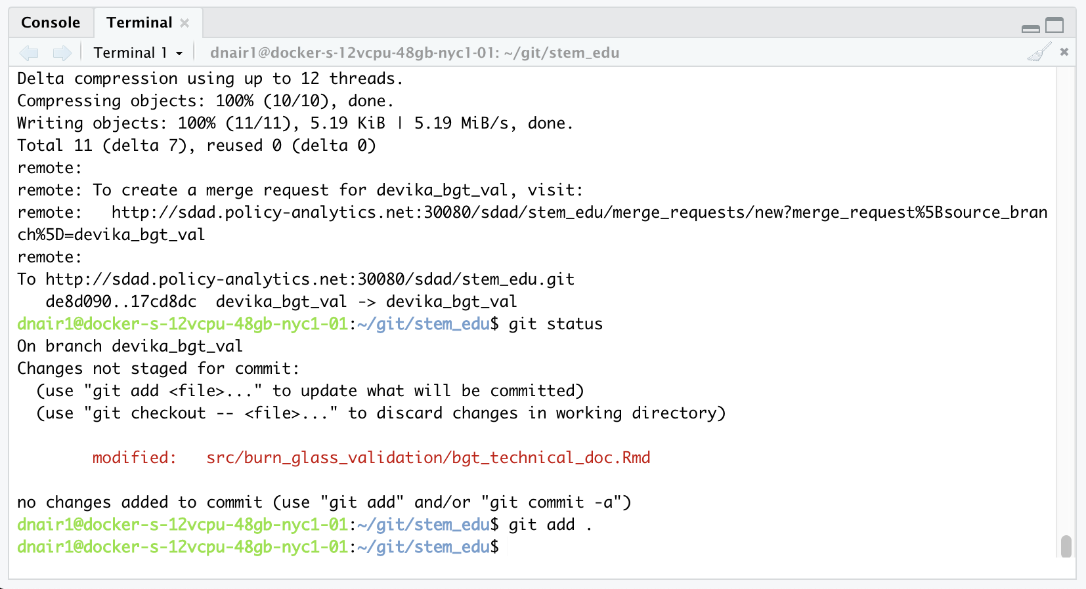
How does git work?
2. Stage your code

Slide 21
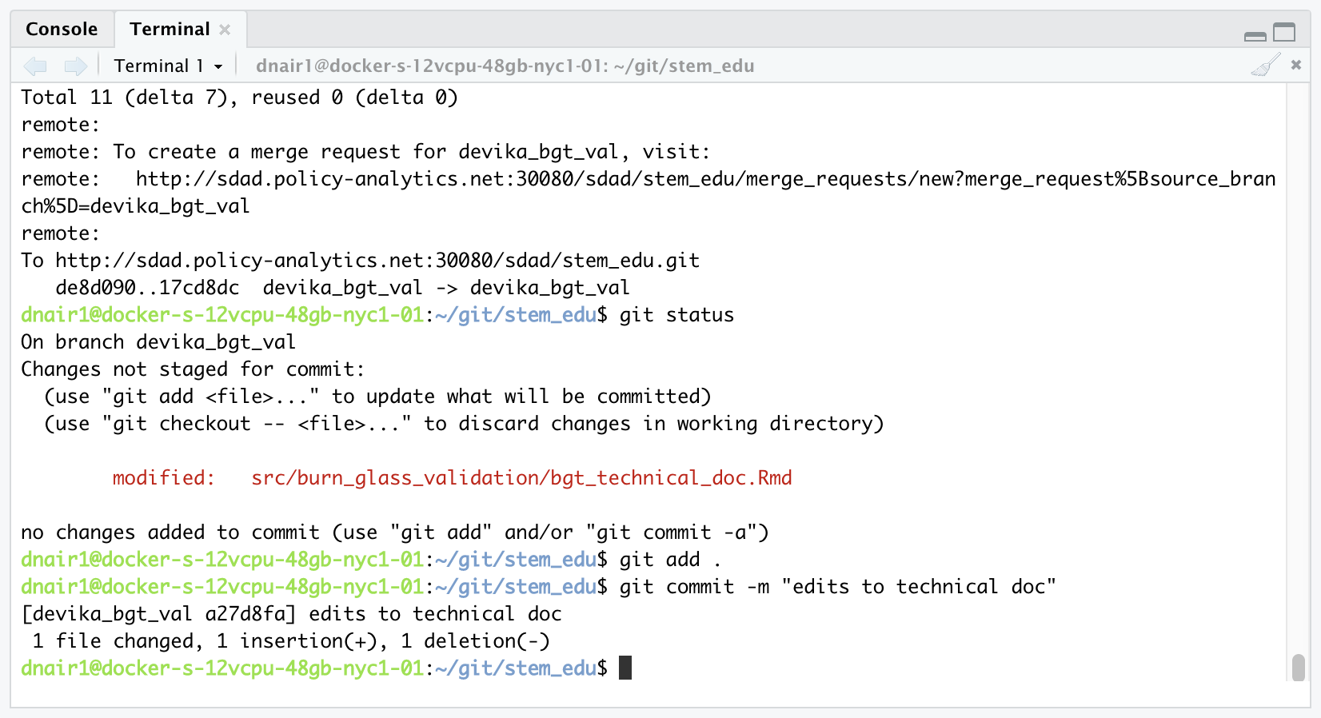
How does git work?
2. Commit your code

Slide 22
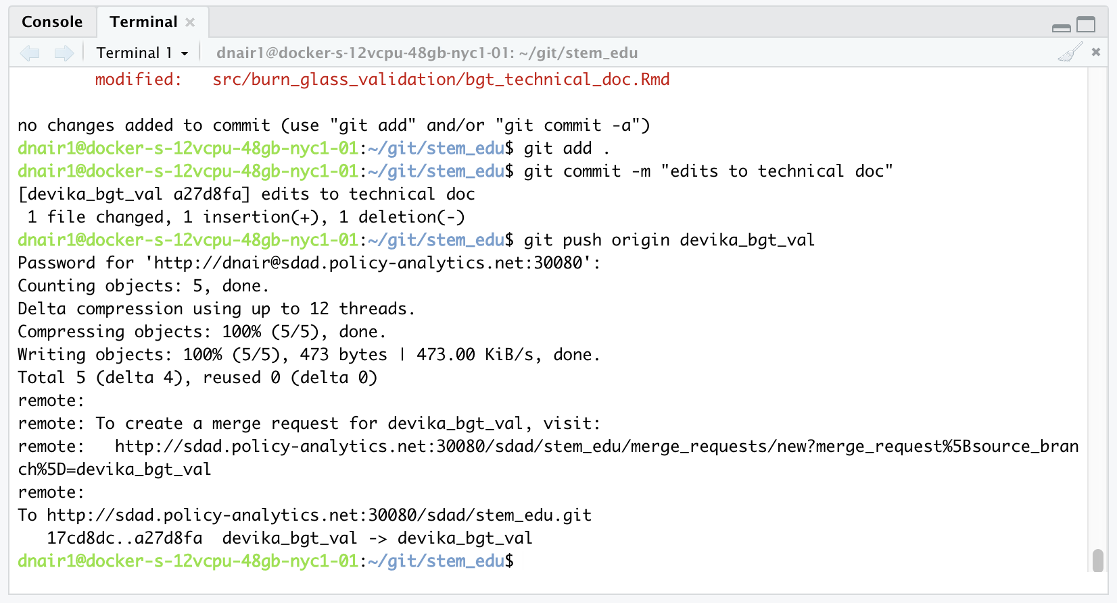
How does git work?
4. Push your code

Slide 23
Exercise
Git Test Code
Open your stem_edu project
Write Code
File
New R script
Enter test stuff, like
#I AM WRITING CODE
mtcars
Save file as test.R
In Terminal
git status
git checkout –b [name]
git add .
git commit –m “wrote stuff”
git push origin [name]
Enter GitHub password
git status
Navigate to GitHub – Is your newest code available?

Slide 24
Exercise – What just happened?
Git Test Code
You made changes to your code on the server
This works when you are the sole writer of code on your project.
But what if you aren’t?
You sent those changes to GitHub via Terminal
GitHub now shows the latest version

Slide 25
Just remember – BWPM
Branch
Write
Push
Merge
Branch
Create git branch
Write
Write your code!
Push
Add your changes
Push your branch
Merge
Commit the changes
Review your code
Merge your branches
Merge branch into master
Delete your branch
Pull latest master
Bran
Writes
Pushy
Memos
Notes:
Big Waffles Pantry Materials
Black White Panda Mate
BoWPaM
Big Waves Paddle Motorboat
Banana Watermelon Pear Mango
Bran of Winterfell
Braavos Winterfell Pentos/Pit Meereen
Bran Writes Pushy Merger

Slide 26

0. Make sure you are in your project repository, either of these two ways:
Navigate to your project repo by opening the .Rproj file in Files
Use Terminal command line to:
To check your working directory: pwd
To see contents of folder: ls -a
To move into folder below: cd foldername
To move into folder above: cd ..
Master
DSPG_branch
Make sure your master branch is up to date
Go to the master branch: git checkout master
Update your master branch: git pull origin master
Create a new branch (give it a useful name): git checkout -b my_awesome_task
Give your branch a sensible name about what you are working on
Add your name or initials to branch name
Go code and write commits!
git add <my file>
git commit -m 'look at all this cool stuff’
Push your branch git push origin my_awesome_task
Issue a pull request
Have someone (maintainers) review your code
(Maintainers) merge the pull request
You can also checkoff a box that will also delete the branch on the remote
Or delete the branch manually under the branches view
Go back to master: git checkout master
Pull down your merged code: git pull origin master
Delete your branch: git branch -d my_awesome_task (note it is a lower case d)
Clean up your branches: git fetch --prune

Slide 27
Git Lucky
Git Collaboration
Git Branches
Git Push
Git Merge
Git Pull

Slide 28
Git Branches
Master Branch:
Functional combination of all team members’ code
Branch:
A copy of the code that is undergoing development
Branch:
A copy of the code that is undergoing development
Branch:
A copy of the code that is undergoing development
Notes:
A version control system is a tool that manages changes made to the files and directories in a project. Many version control systems exist; this lesson focuses on one called Git, which is used by many of the data science tools covered in our other lessons. Its strengths are:
Nothing that is saved to Git is ever lost, so you can always go back to see which results were generated by which versions of your programs.
Git automatically notifies you when your work conflicts with someone else's, so it's harder (but not impossible) to accidentally overwrite work.
Git can synchronize work done by different people on different machines, so it scales as your team does.
Version control isn't just for software: books, papers, parameter sets, and anything that changes over time or needs to be shared can and should be stored and shared using something like Git.

Slide 29
Git Branches
Master Branch:
Functional combination of all team members’ code
Example:
Business Innovation – detecting innovation in text sources
Branch:
A copy of the code that is undergoing development
Gizem Task:
Gizem working to import journal articles text data
Branch:
A copy of the code that is undergoing development
Devika Task:
Devika working to articulate data structure and data types of articles
Branch:
A copy of the code that is undergoing development
Teja Task:
Teja working to import and clean FDA data for subsequent validation
Notes:
A version control system is a tool that manages changes made to the files and directories in a project. Many version control systems exist; this lesson focuses on one called Git, which is used by many of the data science tools covered in our other lessons. Its strengths are:
Nothing that is saved to Git is ever lost, so you can always go back to see which results were generated by which versions of your programs.
Git automatically notifies you when your work conflicts with someone else's, so it's harder (but not impossible) to accidentally overwrite work.
Git can synchronize work done by different people on different machines, so it scales as your team does.
Version control isn't just for software: books, papers, parameter sets, and anything that changes over time or needs to be shared can and should be stored and shared using something like Git.

Slide 30
Git Branches
Example:
Business Innovation – detecting innovation in text sources
Branch Name:
factiva_gizem
Scripts:
import_factiva.R
import_factiva_meta.R
Save your work!
Branches are pushed up to GitHub for code review.
(git status, git add, git commit, git push)
Gizem Task:
Gizem working to import journal articles text data
Devika Task:
Devika working to articulate data structure and data types of articles
Branch Name:
factiva_devika
Scripts:
import_factiva.R
clean_factiva.R
Teja Task:
Teja working to import and clean FDA data for subsequent validation
Branch Name:
fda_teja
Scripts:
import_FDA.R
clean_FDA.R
Conflicts?
Scripts written independently are fine.
Gizem and Devika both collaborated on import_factiva.R so this code will need to be reviewed.
Notes:
A version control system is a tool that manages changes made to the files and directories in a project. Many version control systems exist; this lesson focuses on one called Git, which is used by many of the data science tools covered in our other lessons. Its strengths are:
Nothing that is saved to Git is ever lost, so you can always go back to see which results were generated by which versions of your programs.
Git automatically notifies you when your work conflicts with someone else's, so it's harder (but not impossible) to accidentally overwrite work.
Git can synchronize work done by different people on different machines, so it scales as your team does.
Version control isn't just for software: books, papers, parameter sets, and anything that changes over time or needs to be shared can and should be stored and shared using something like Git.

Slide 31
Git Branch Workflow
Git Branching
Check git branch
Create git branch
Write your code
Push your code
Merge your code
Note: you already know how to write and push your code!

Slide 32
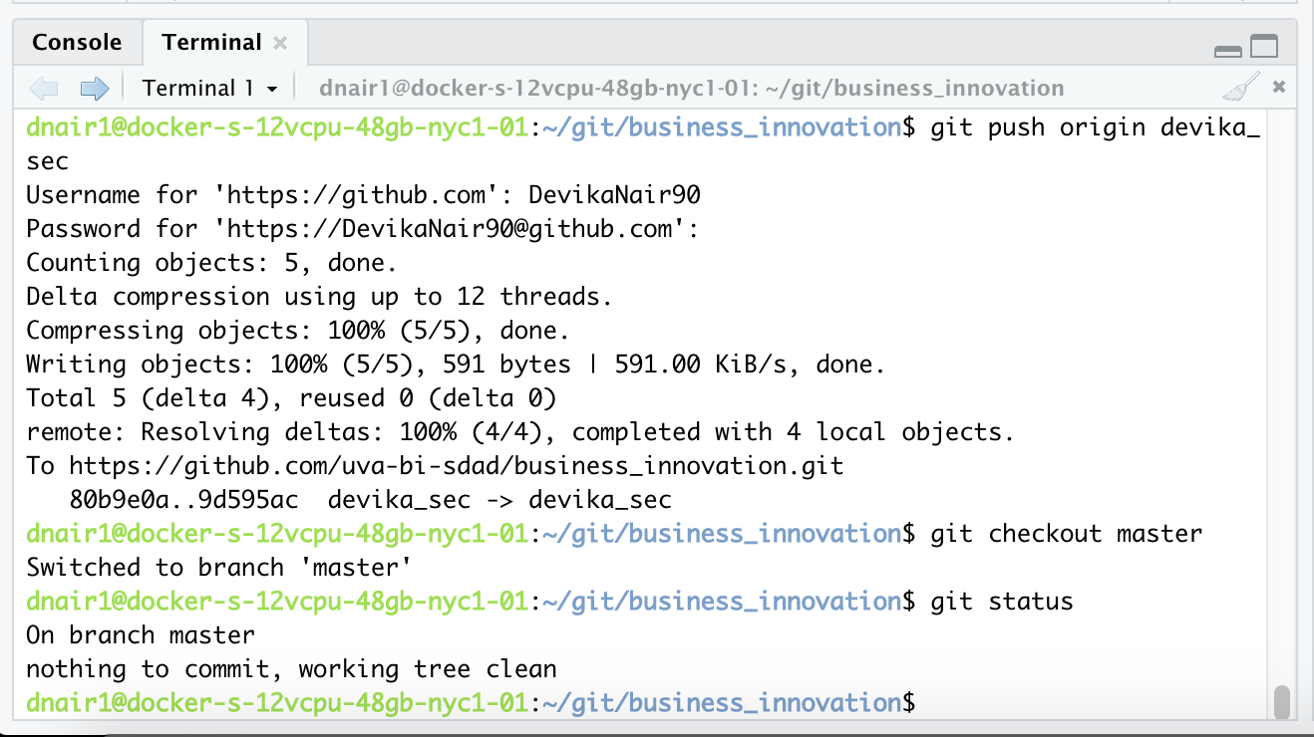
How does git work?
1. Check git branch
Notes:
CheckC2.

Slide 33
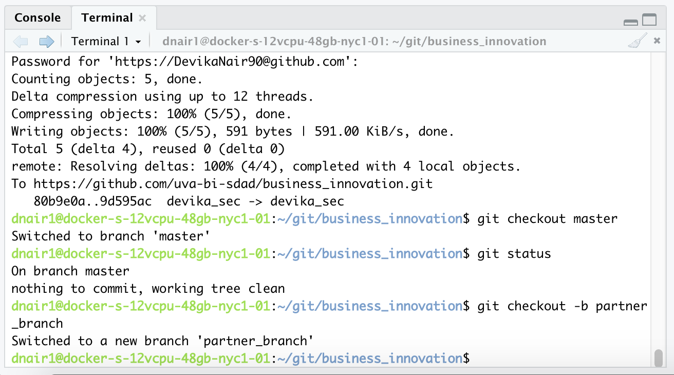
How does git work?
2. Create git branch
Notes:
2.

Slide 34
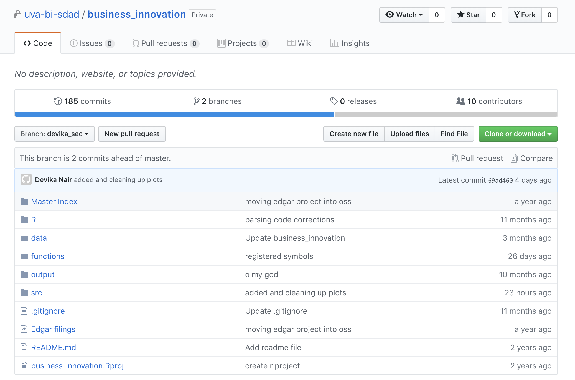
How does git work?
3. Write your code
4. Push your code
5. Merge your code

Slide 35
Exercise
Git Test Code
Teams of 2
Clone your partner’s personal project (see Come Togither slide)
Make partner collaborator on your project
In Terminal
Check what branch you’re on using git status
Create a new branch for yourself using git checkout -b partner_branch
In Console
Open your partner’s test.R script
Make a change to the script, like changing mtcars to head(mtcars)
In Terminal
Check that the test.R script appears as modified using git status
git add .
git commit –m “updated partner’s test script”
git push origin branchname
Enter GitHub password
git status
Navigate to GitHub – Is your newest branch available?
Check git branch
Create git branch
Write your code
Push your code

Slide 36
Exercise - what did we just do?
Example:
Personal project
Branch Name:
master
Scripts:
test.R
Save your work!
Branches are pushed up to GitHub for code review.
(git status, git add, git commit, git push)
Partner A Task:
Partner A looking at mtcars data
Partner B Task:
Partner B decided we only needed to look at first 6 rows of mtcars
Branch Name:
partner_branch
Scripts:
test.R
Notes:
A version control system is a tool that manages changes made to the files and directories in a project. Many version control systems exist; this lesson focuses on one called Git, which is used by many of the data science tools covered in our other lessons. Its strengths are:
Nothing that is saved to Git is ever lost, so you can always go back to see which results were generated by which versions of your programs.
Git automatically notifies you when your work conflicts with someone else's, so it's harder (but not impossible) to accidentally overwrite work.
Git can synchronize work done by different people on different machines, so it scales as your team does.
Version control isn't just for software: books, papers, parameter sets, and anything that changes over time or needs to be shared can and should be stored and shared using something like Git.

Slide 37
Git Merge
Create pull request
(pull request = merge request)
Notes:
merge aka "pull" request
LINK

Slide 38
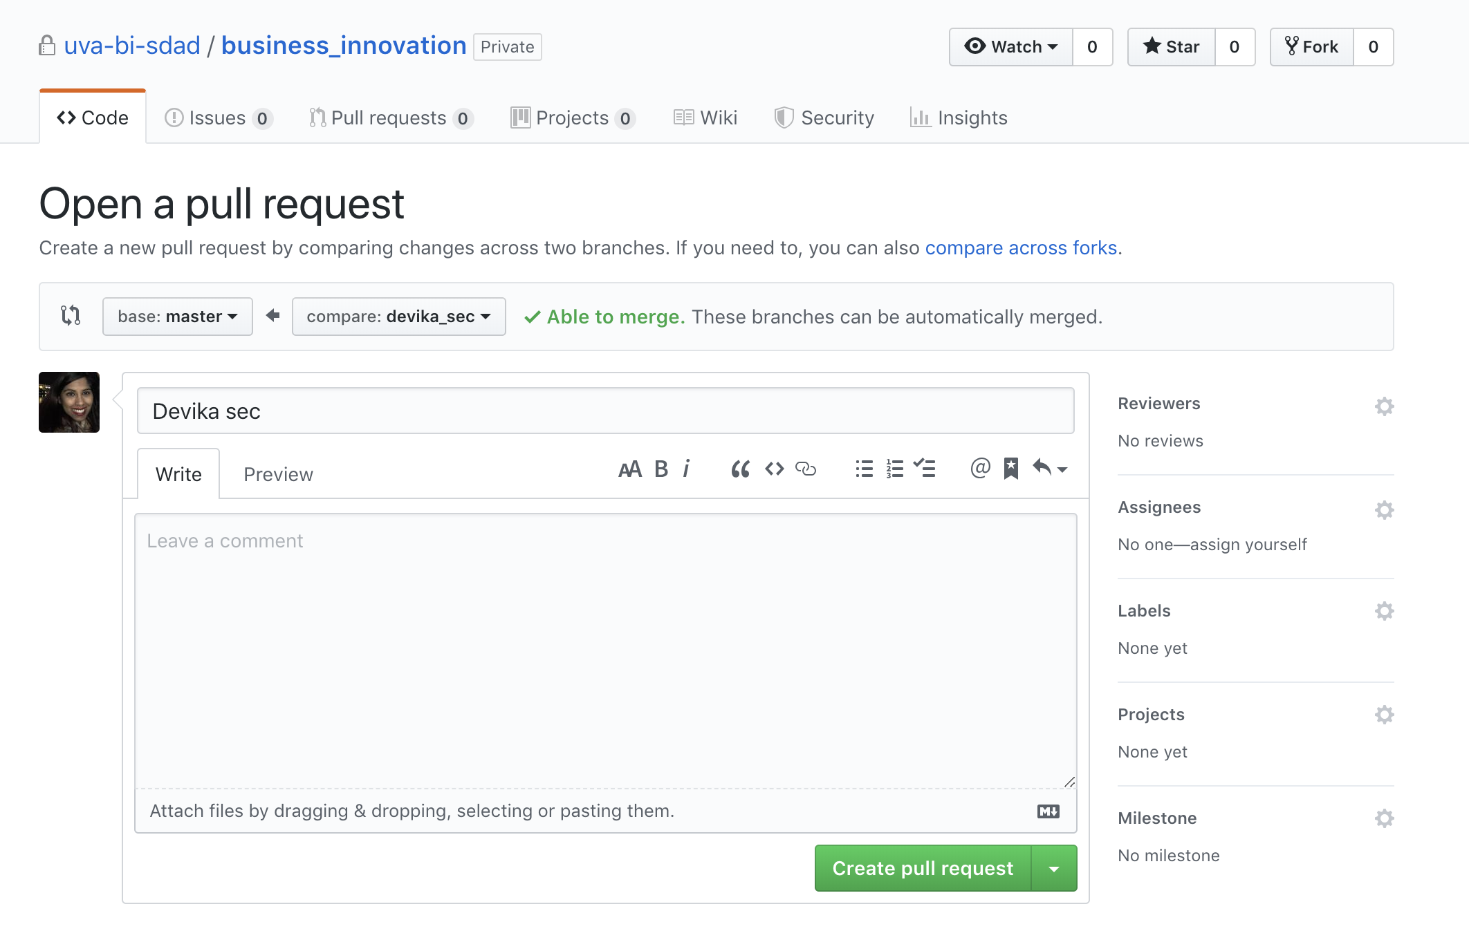
Git Merge
Create pull request
Notes:
merge aka "pull" request
LINK

Slide 39
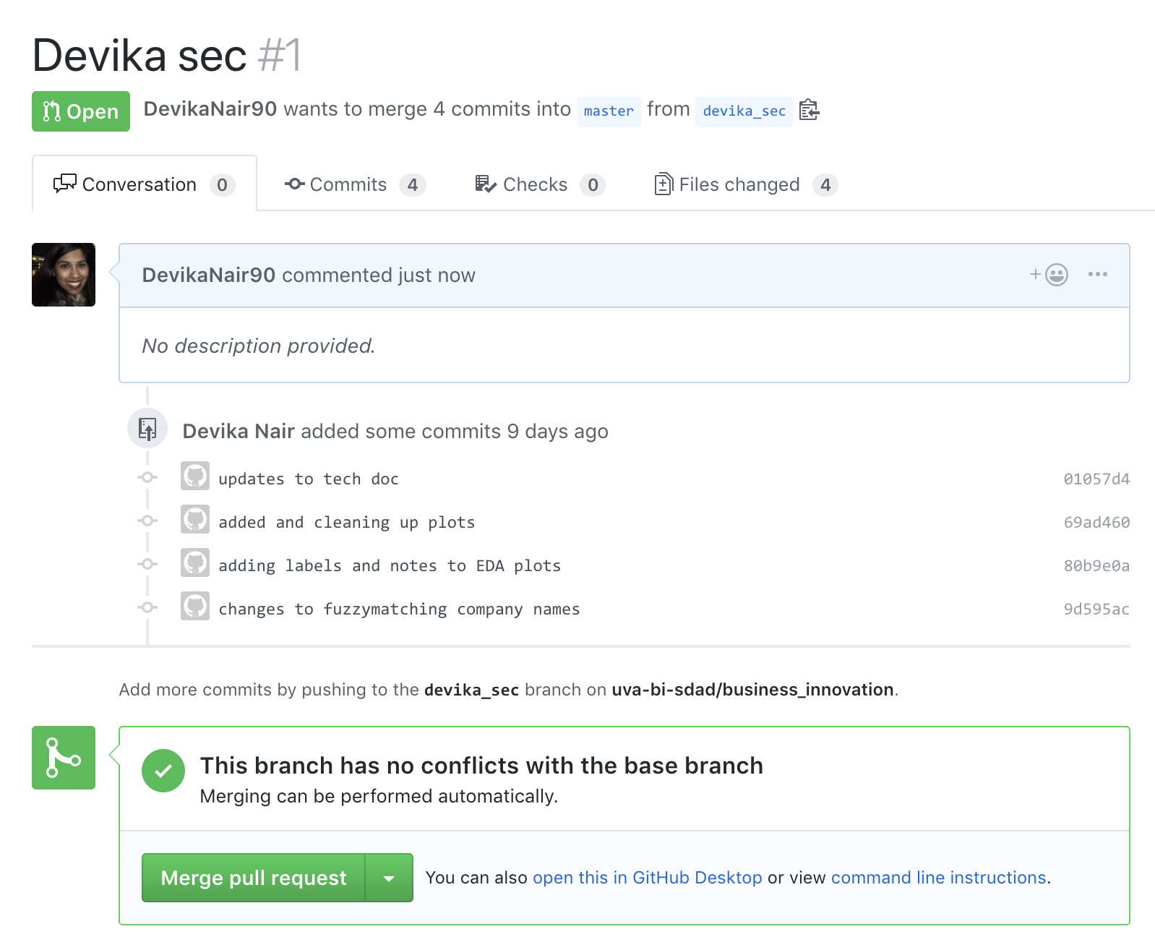
Git Merge
Check for conflicts
Notes:
merge aka "pull" request
LINK

Slide 40
Git Merge
Check for conflicts
Notes:
merge aka "pull" request
LINK

Slide 41
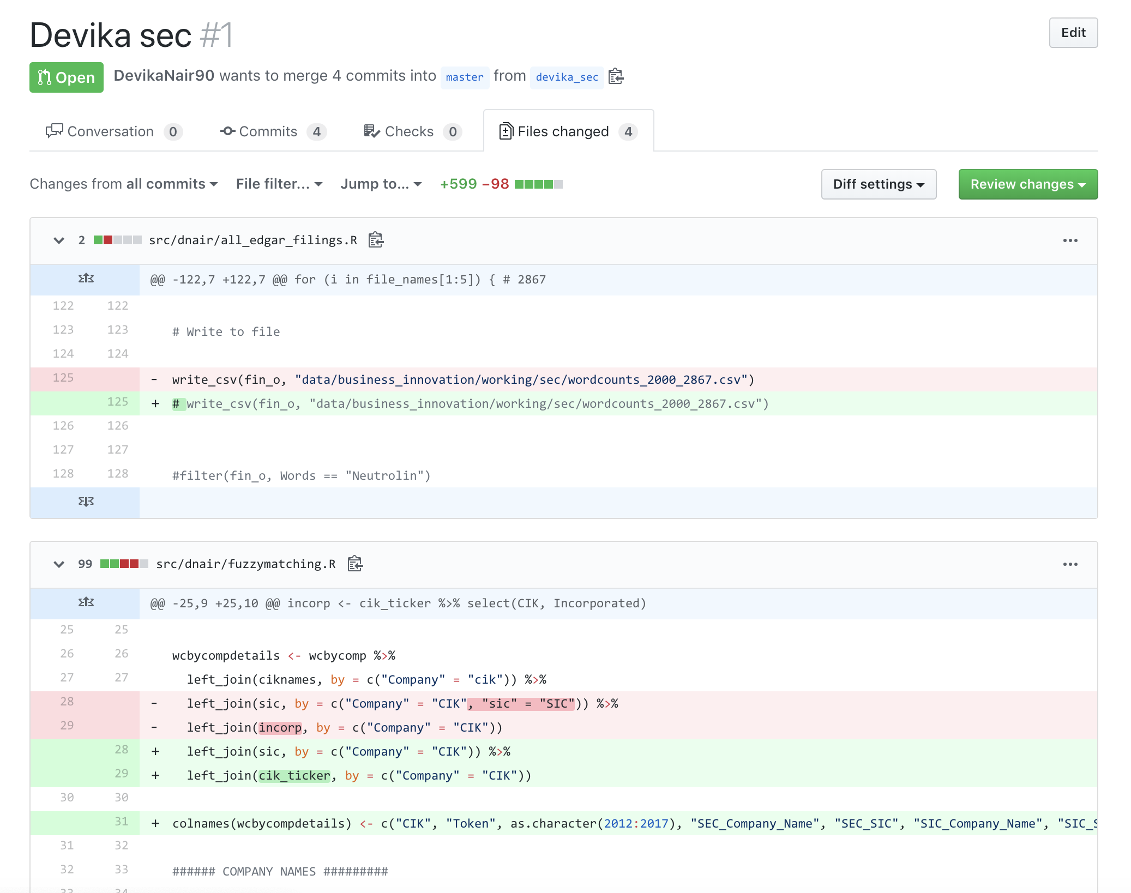
Git Merge
Review code changes
Notes:
merge aka "pull" request
LINK

Slide 42
Just remember – BWPM
Branch
Write
Push
Merge
Branch
Check git branch
Create git branch
Write
Write your code!
Push
Add your changes
Push your branch
Merge
Commit the changes
Review your code
Merge your branches
Merge branch into master
Bran
Writes
Pushy
Memos
Notes:
Big Waffles Pantry Materials
Black White Panda Mate
BoWPaM
Big Waves Paddle Motorboat
Banana Watermelon Pear Mango
Bran of Winterfell
Braavos Winterfell Pentos/Pit Meereen
Bran Writes Pushy Merger

Slide 43
COVER YOUR EARS
Notes:
Big Waffles Pantry Materials
Black White Panda Mate
BoWPaM
Big Waves Paddle Motorboat
Banana Watermelon Pear Mango
Bran of Winterfell
Braavos Winterfell Pentos/Pit Meereen
Bran Writes Pushy Merger

Slide 44
Just remember – BWPM
Branch
Write
Push
Merge
Branch
Check git branch
Create git branch
Write
Write your code!
Push
Add your changes
Push your branch
Merge
Commit the changes
Review your code
Merge your branches
Merge branch into master
Bran
Writes 0 ravens?
gets Pushed
Emerges winner
Notes:
Big Waffles Pantry Materials
Black White Panda Mate
BoWPaM
Big Waves Paddle Motorboat
Banana Watermelon Pear Mango
Bran of Winterfell
Braavos Winterfell Pentos/Pit Meereen
Bran Writes Pushy Merger

Slide 45
0. Make sure you are in your project repository, either of these two ways:
Navigate to your project repo by opening the .Rproj file in Files
Use Terminal command line to:
To check your working directory: pwd
To see contents of folder: ls -a
To move into folder below: cd foldername
To move into folder above: cd ..
Master
DSPG_branch
Make sure your master branch is up to date
Go to the master branch: git checkout master
Update your master branch: git pull origin master
Create a new branch (give it a useful name): git checkout -b my_awesome_task
Give your branch a sensible name about what you are working on
Add your name or initials to branch name
Go code and write commits!
git add <my file>
git commit -m 'look at all this cool stuff’
Push your branch git push origin my_awesome_task
Issue a pull request
Have someone (maintainers) review your code
(Maintainers) merge the pull request
You can also checkoff a box that will also delete the branch on the remote
Or delete the branch manually under the branches view
Go back to master: git checkout master
Pull down your merged code: git pull origin master
Delete your branch: git branch -d my_awesome_task (note it is a lower case d)
Clean up your branches: git fetch --prune

